Slide 1


Sparse Coding
Daoxiang Zhou
School of Software Engineering
Chongqing University

Slide 2
Outline
1
What
2
Why
3
Broader view
4
How
5
Hierarchical

Slide 3
1
P
1
art
What

Slide 4

What
Slide credit: Andrew Ng

Slide 5
What
Learn a better way to
represent image than pixels
Slide credit: Andrew Ng

Slide 6
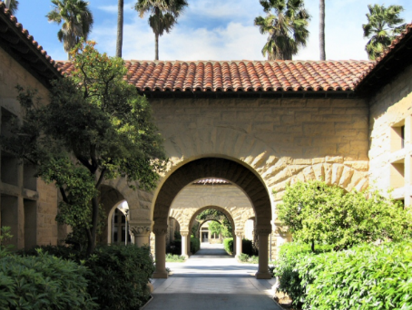
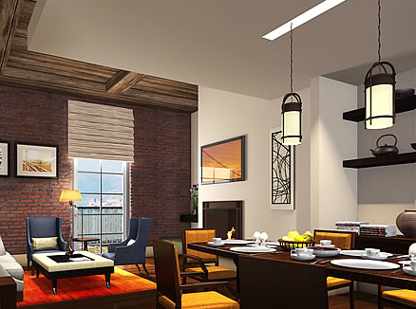
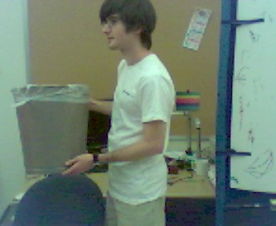
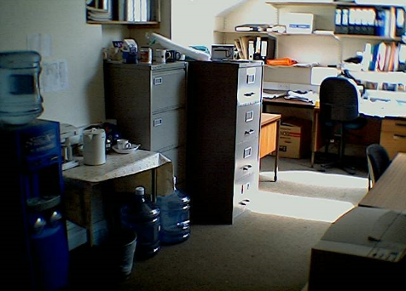
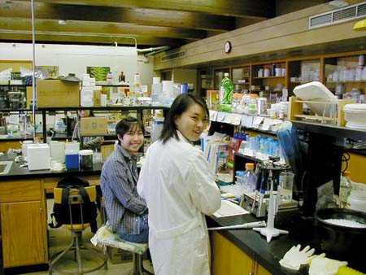
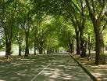
What
Learn a better way to
represent image than pixels
Slide credit: Andrew Ng

Slide 7
What
Slide credit: Andrew Ng

Slide 8
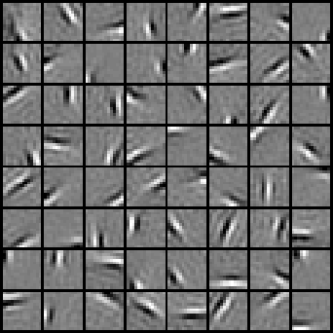



What
Slide credit: Andrew Ng

Slide 9
What
≈
Slide credit: Andrew Ng

Slide 10



What
≈ 0.8 * + 0.3 * + 0.5 *
Slide credit: Andrew Ng

Slide 11
What
≈ 0.8 * + 0.3 * + 0.5 *
x ≈ 0.8 * φ₃₆ + 0.3 * φ₄₂ + 0.5 * φ₆₃
[a₁, …, a₆₄] = [0, 0, …, 0, 0.8, 0, …, 0, 0.3, 0, …, 0, 0.5, 0] (feature representation)
Slide credit: Andrew Ng

Slide 12
What
Input: Patch x_{i} ( in R^{d} ) and previously learned ϕ_{i} (i=1,… ,k)
Output: Representation [a_{i,1}, a_{i,2}, … , a_{i,k}] of image patch x_{i}
Slide credit: Andrew Ng

Slide 13
What
Input: Patch x_{i} ( in R^{d} ) and previously learned ϕ_{i} (i=1,… ,k)
Output: Representation [a_{i,1}, a_{i,2}, … , a_{i,k}] of image patch x_{i}
≈ 0.8 * + 0.3 * + 0.5 *
Slide credit: Andrew Ng

Slide 14
What
Input: Patch x_{i} ( in R^{d} ) and previously learned ϕ_{i} (i=1,… ,k)
Output: Representation [a_{i,1}, a_{i,2}, … , a_{i,k}] of image patch x_{i}
l₁ sparsity term
Slide credit: Andrew Ng

Slide 15
What
Input: Patch x_{i} ( in R^{d} ) and previously learned ϕ_{i} (i=1,… ,k)
Output: Representation [a_{i,1}, a_{i,2}, … , a_{i,k}] of image patch x_{i}
l₁ sparsity term
Alternating optimization:
Fix dictionary ϕ, optimize a (LASSO problem） Harder
Fix activations a, optimize dictionary ϕ (convex QP problem) Easy
Slide credit: Andrew Ng & Kai Yu

Slide 16
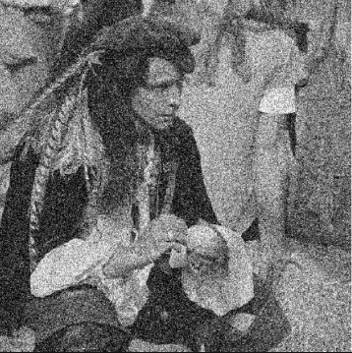
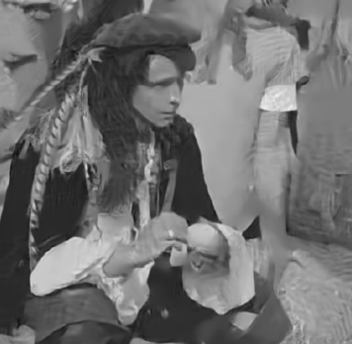
What
Denoising

Slide 17
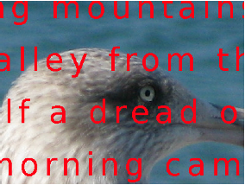
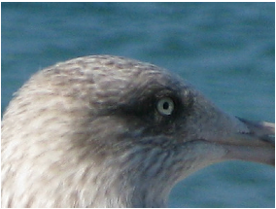
What
Inpainting

Slide 18
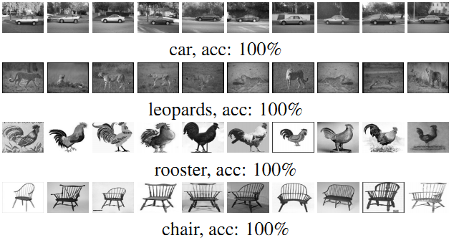
What
Image Classification

Slide 19
1
P
2
art
Why

Slide 20
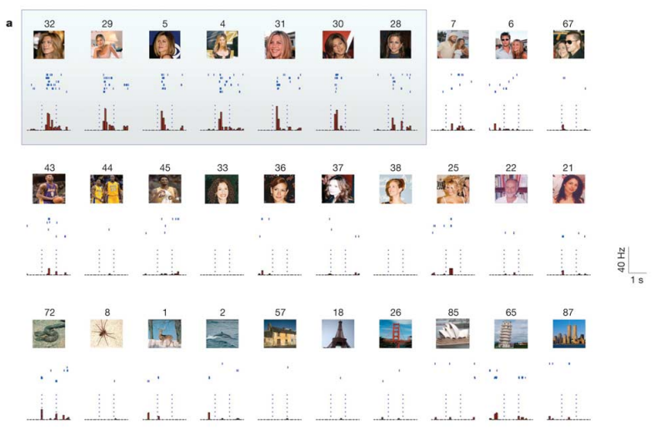
Why
Grandmother cell
[Quiroga, Reddy, & Kreiman Nature2005]

Slide 21
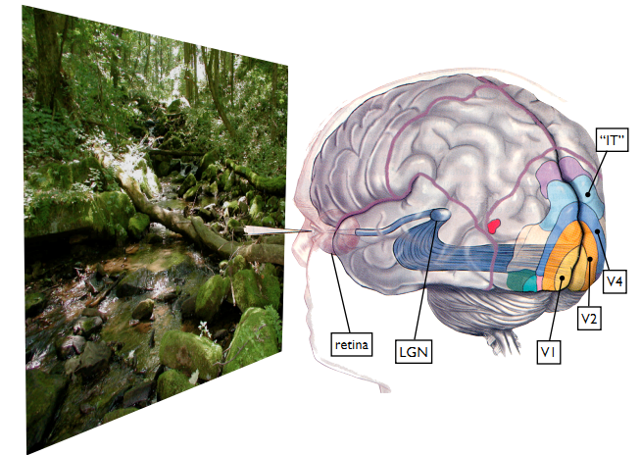
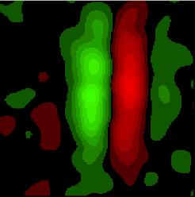
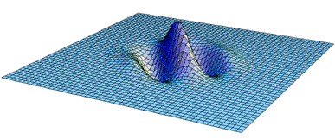
Why
[Olshausen, Field. Nature1996]

Slide 22

Why
Believing in everything at the same time
is the same as not believing in anything at all

Slide 23
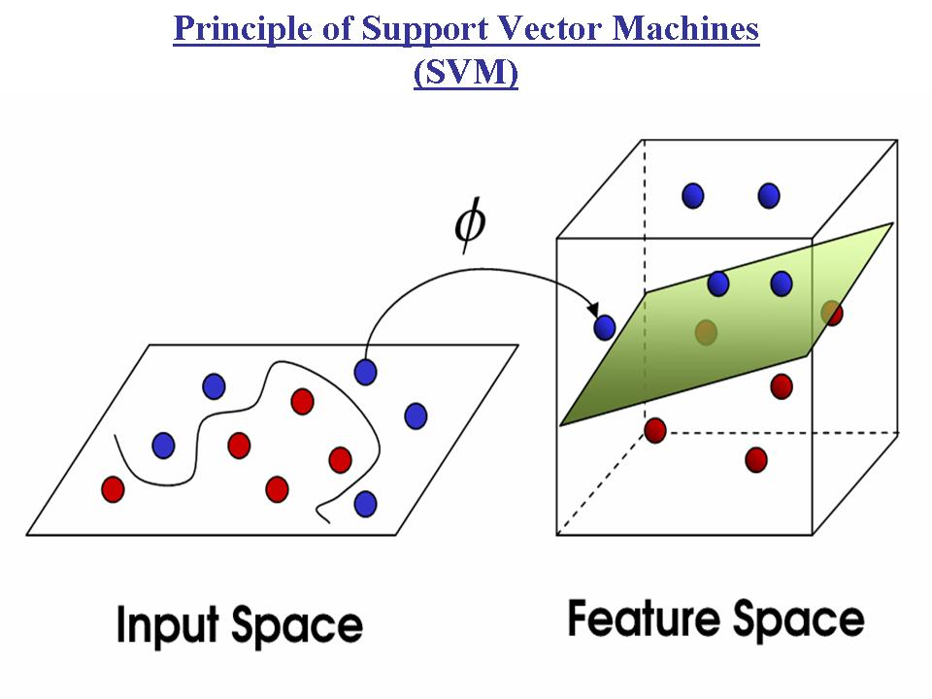
Why
The coding is a nonlinear feature mapping
Represent data in a higher dimensional space
Sparsity makes prominent patterns more distinctive

Slide 24
Why
Data manifold
Basis
Basis
Each basis is somewhat like a pseudo data point – “anchor point”
Sparsity: each datum is a sparse combination of neighbor anchors.
The coding scheme explores the manifold structure of data.
Slide credit: Kai Yu & Andrew Ng

Slide 25
Why
Data manifold
Data
Basis
Basis
Each basis is somewhat like a pseudo data point – “anchor point”
Sparsity: each datum is a sparse combination of neighbor anchors.
The coding scheme explores the manifold structure of data.
Slide credit: Kai Yu & Andrew Ng

Slide 26
Why

Slide 27
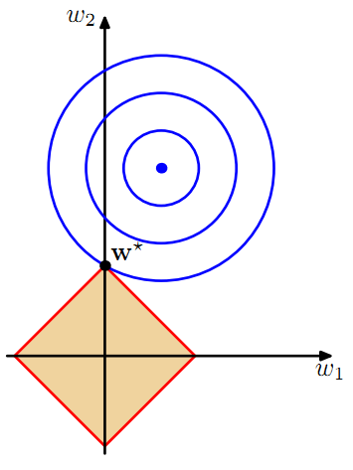
Why
l₁

Slide 28
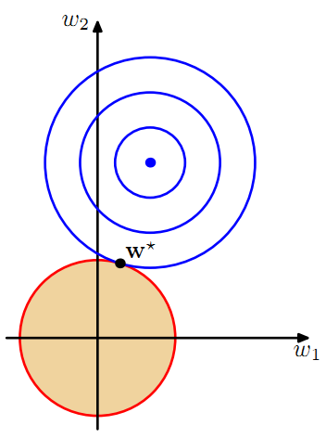
Why
l₁
l₂

Slide 29
Why
l₁
l₂
Demo

Slide 30
Introduction
Some toolbox
Sparse Representation
http://perception.csl.illinois.edu/recognition/Home.html
SPArse Modeling Software
http://spams-devel.gforge.inria.fr/downloads.html
Sparse Representation Toolbox in MATLAB
https://sites.google.com/site/sparsereptool/
SLEP: Sparse Learning with Efficient Projections
http://www.yelab.net/software/SLEP/

Slide 31
1
P
4
art
Broader view

Slide 32
Broader view
a is sparse
a is often higher dimension than x
Activation a=f(x) is nonlinear implicit function of x
reconstruction x’=g(a) is linear & explicit
a
a
f(x)
encoding
g(a)
decoding
x
x’
Slide credit: Kai Yu

Slide 33
Broader view
RBM & AE
also involve activation and reconstruction
but have explicit f(x)
not necessarily enforce sparsity on a
but if put sparsity on a, often get improved results
a
a
f(x)
encoding
g(a)
decoding
x
x’
Slide credit: Kai Yu

Slide 34
Broader view
Sparse coding: A broader view
Any feature mapping from x to a, i.e. a = f(x), where
a is sparse (and often higher dim. than x)
f(x) is nonlinear
reconstruction x’=g(a) , such that x’≈x
a
a
f(x)
g(a)
x
x’
sparse RBMs, sparse auto-encoder, even VQ can be viewed as a form of sparse coding.
Slide credit: Kai Yu

Slide 35
Broader view
VQ Coding
Centroid 1
Centroid 2
Centroid 3
Slide credit: Andrew Ng

Slide 36
Broader view
VQ Coding
Sparse coding
Centroid 1
Basis φ₁
Basis φ₂
Centroid 2
Centroid 3
Basis φ₃
Slide credit: Andrew Ng

Slide 37
Broader view
VQ Coding
Sparse coding
Centroid 1
Basis φ₁
Basis φ₂
Centroid 2
Centroid 3
Basis φ₃
Slide credit: Andrew Ng

Slide 38
Broader view
SAE

Slide 39
Broader view
SAE

Slide 40
Broader view
SAE
`

Slide 41
Broader view
sparsity
No sparsity

Slide 42
Broader view
sparsity
No sparsity
Demo

Slide 43
Broader view
SRBM

Slide 44
Broader view
SRBM

Slide 45
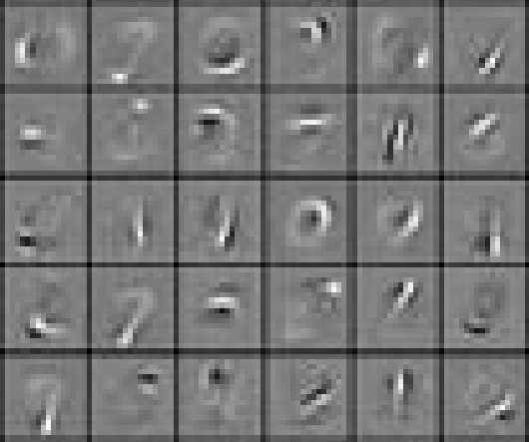
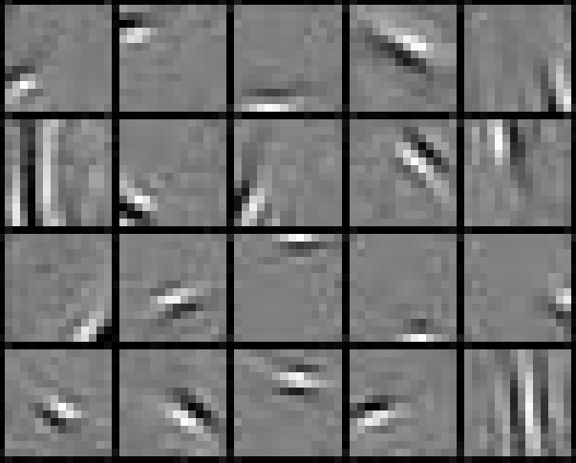
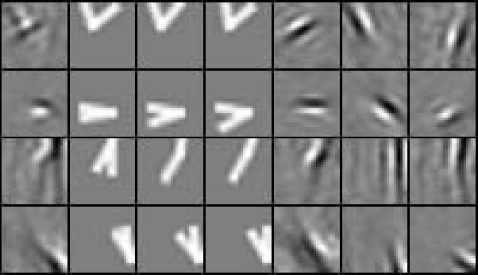
Broader view
SRBM
V1
V2

Slide 46
1
P
4
art
How

Slide 47
How
≈ 0.8 * + 0.3 * + 0.5 *
Slide credit: Andrew Ng

Slide 48

How
≈ 0.8 * + 0.3 * + 0.5 *
Sparse Coding
Spatial Max Pooling
Linear SVM
50%
Slide credit: Kai Yu

Slide 49
How
≈ 0.8 * + 0.3 * + 0.5 *
Dense SIFT
Sparse Coding
VQ Coding
Spatial Max Pooling
Spatial Pooling
Linear SVM
Nonlinear SVM
50%
64%
Slide credit: Kai Yu

Slide 50
How
≈ 0.8 * + 0.3 * + 0.5 *
Three ways to make it competitive:
Combine this with SIFT.
Advanced versions of sparse coding (LLC).
Deep learning.
Dense SIFT
Sparse Coding
VQ Coding
Spatial Max Pooling
Spatial Pooling
Linear SVM
Nonlinear SVM
50%
64%
Slide credit: Kai Yu

Slide 51
How
Combine this with SIFT
Sparse Coding
Dense SIFT
Dense SIFT
Spatial Max Pooling
VQ Coding
Sparse Coding
Spatial Pooling
Spatial Max Pooling
Linear SVM
Nonlinear SVM
Linear SVM
64%
73%
50%
Slide credit: Kai Yu

Slide 52
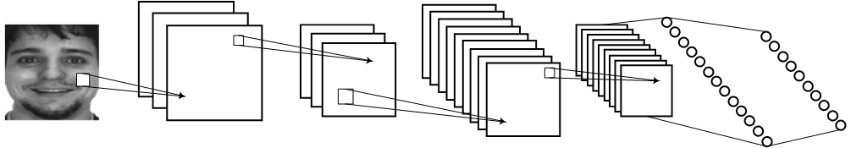
How
Output label
Local Gradients
Pooling
VQ Coding
Average Pooling
Nonlinear SVM
SIFT or HOG
[Sydorov, Sakurada & Lampert, CVPR2014]
Slide credit: Kai Yu

Slide 53
How
Output label
Local Gradients
Pooling
VQ Coding
Average Pooling
Nonlinear SVM
SIFT or HOG
Output label
Local Gradients
Pooling
Sparse Coding
Max pooling
Linear Classifier
SIFT or HOG
[Yang, Yu, Gong & Huang, CVPR09]
Slide credit: Kai Yu

Slide 54
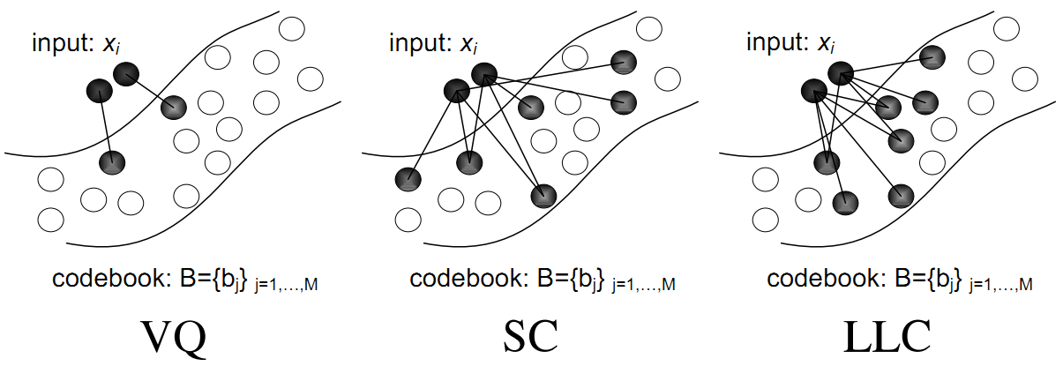
Introduction
LLC
[Wang, Yang, Yu et al. CVPR2010]

Slide 55
1
P
4
art
Hierarchical

Slide 56
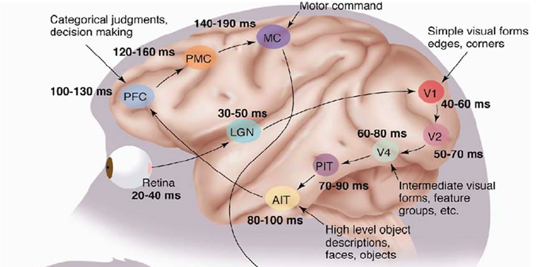
Hierarchical
Theoretical
“…well-known depth-breadth tradeoff in circuits design [Hastad 1987]. This suggests many functions can be much more efﬁciently represented with deeper architectures…”
[Bengio & LeCun 2007]

Slide 57
Hierarchical
CNN
Output label
Coding
Pooling
Coding
Pooling
[LeCun, Boser, Denker et al, NC1989]
Slide credit: Kai Yu

Slide 58
Hierarchical
CNN
Output label
Coding
Pooling
Coding
Pooling
[LeCun, Boser, Denker et al, NC1989]
Slide credit: Kai Yu

Slide 59
Hierarchical
Output label
Sparse coding
Pooling
Sparse coding
Pooling
[Yu, Lin, & Lafferty CVPR2011]
Slide credit: Kai Yu

Slide 60
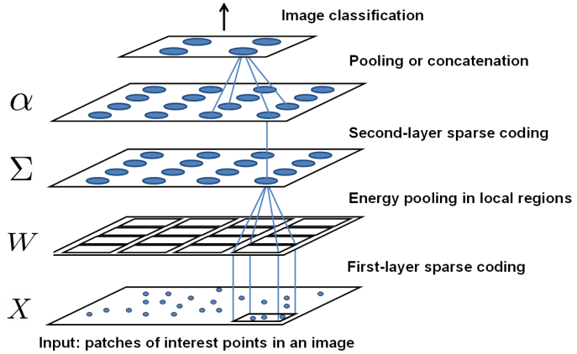
Hierarchical
[Yu, Lin, & Lafferty CVPR2011]

Slide 61
Hierarchical
[Yu, Lin, & Lafferty CVPR2011]
Slide credit: Kai Yu

Slide 62
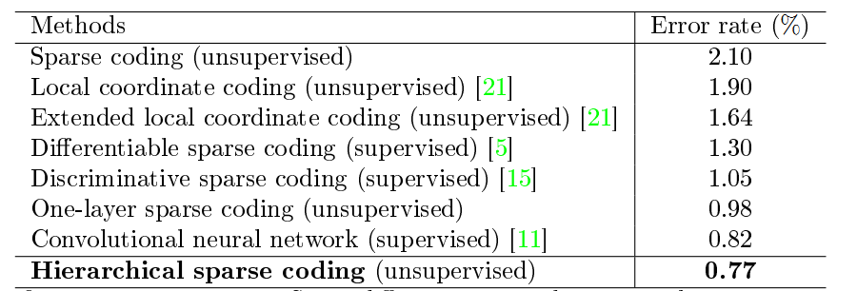
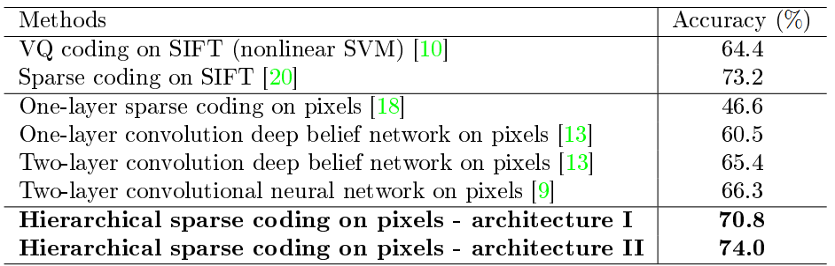
Hierarchical sparse coding
Mnist
Caltech101
[Yu, Lin, & Lafferty CVPR2011]
Slide credit: Kai Yu

Slide 63
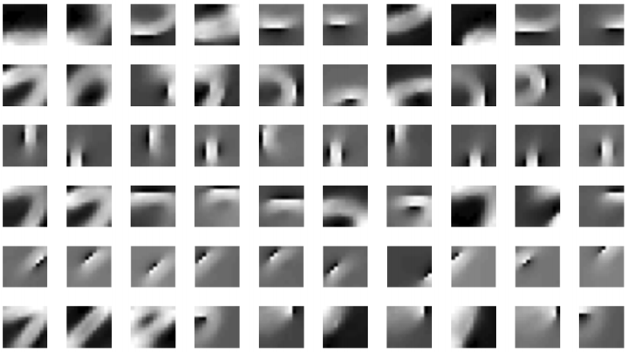
Hierarchical sparse coding
[Yu, Lin, & Lafferty CVPR2011]
Slide credit: Kai Yu

Slide 64
Hierarchical sparse coding
[Yu, Lin, & Lafferty CVPR2011]
Slide credit: Kai Yu

Slide 65
Hierarchical
Hierarchical Convolutional Sparse Coding.
Trained with respect to image from all layers (L1-L4).
Pooling both spatially and amongst features.
Learns invariant mid-level features.
L4 Feature Maps
Select L4 Features
L3 Feature Maps
Select L3 Feature Groups
L2 Feature Maps
L1 Feature Maps
Select L2 Feature Groups
Image
L1 Features
[Zeiler, Taylor, & Fergus, ICCV2011]
Slide credit: Kai Yu

Slide 66
Thanks & Questions

